Slide 1
FOREST FIRE PREDICTION
By
Kumuda B G Murthy
Raghava D Urs
Shiv Kumar Ganesh

Slide 2
Significance to the real world
Forests and wildlife plays an important role in our ecosystem. These vegetation needs to be saved and harnessed for the well-being of all animal life. This is what we leave as a legacy for the future generations. There is an imminent need to control and avoid these outraging fires which destroy the flora and fauna. Wildfires also lead to an economic damage and its necessary to prevent these for economic wellbeing as well.

Slide 3
Big Data and Tools Used
Data Size : 22 years of weather and forest fire data from 1998 to 2020
Tools Used : VSCode, Jupyter Notebook, Google Collab
Veracity : Wildfire and weather data gathered from USDA and NOAA website.
Variety : Semi-structured data from multiple CSV files(containing weather and wildfire data).
Volume : 1.8 Million+ records of wildfire and 10years+ weather data.
Velocity : Python program using ArcGIS to gather the data.

Slide 4
Code and Version Control
Packages : NumPy, Pandas, Seaborn, Matplotlib, Sklearn, Itertools, Streamlit
Predictors : Weather Data, Month, Time of day
Prediction : Whether there is a probability of wildfire event occurrence
ML Model : Logistic Regression, Gaussian Naïve Bayes, SVM, KNN, Decision Tree
Version Ctrl : GitHub
Google Collab : Forest fire google collab

Slide 5
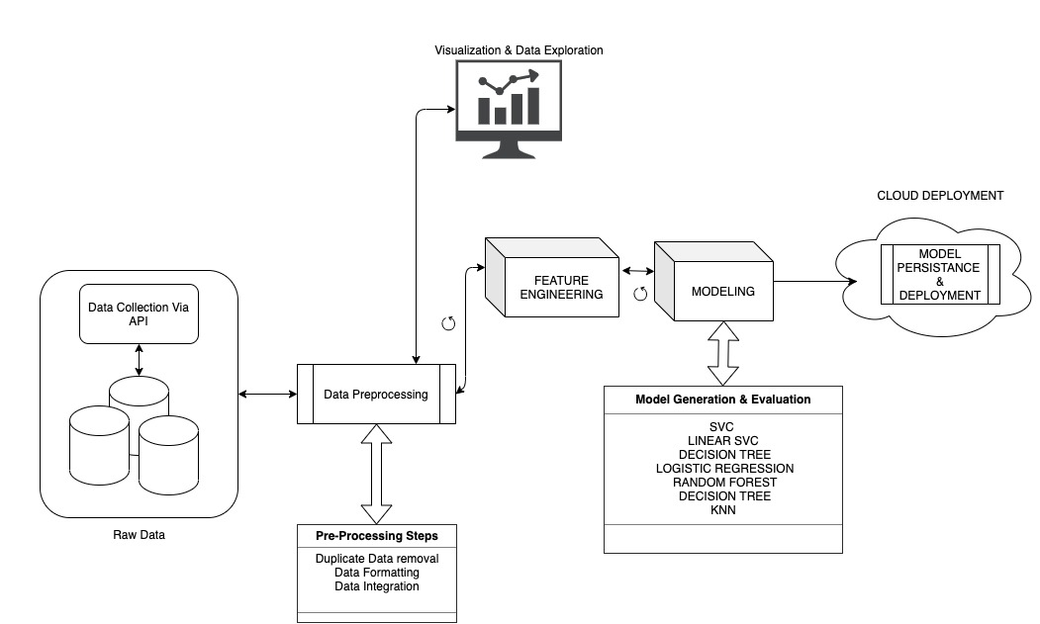
KDD Architecture

Slide 6
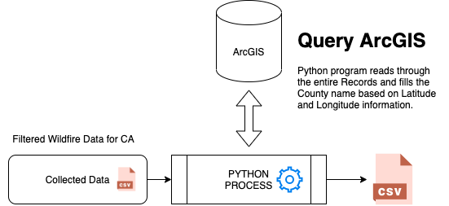
Data Collection
Source : USDA and NOAA website
Data Size : 22 years of weather and forest fire data, 1998 to 2020
Data Format : Semi-structured

Slide 7
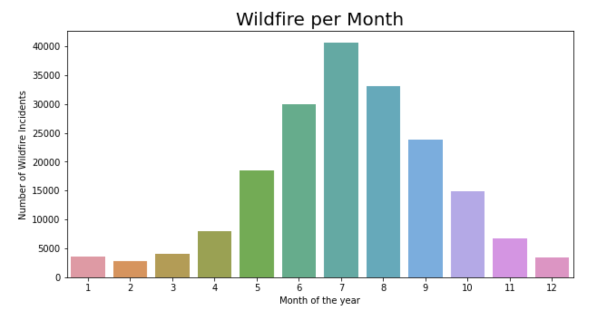
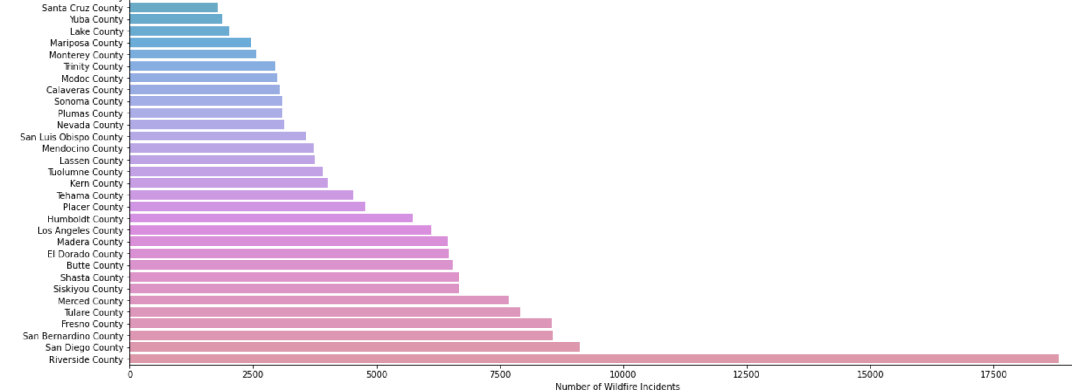
Exploratory Data Analysis
Months of May-September were the one where the number of wildfire events were mostly observed.
Wildfire events based on County
It was also observed that Riverside
County observed most of wildfire events. Based on this observation we considered Riverside County’s Data for further analysis.

Slide 8
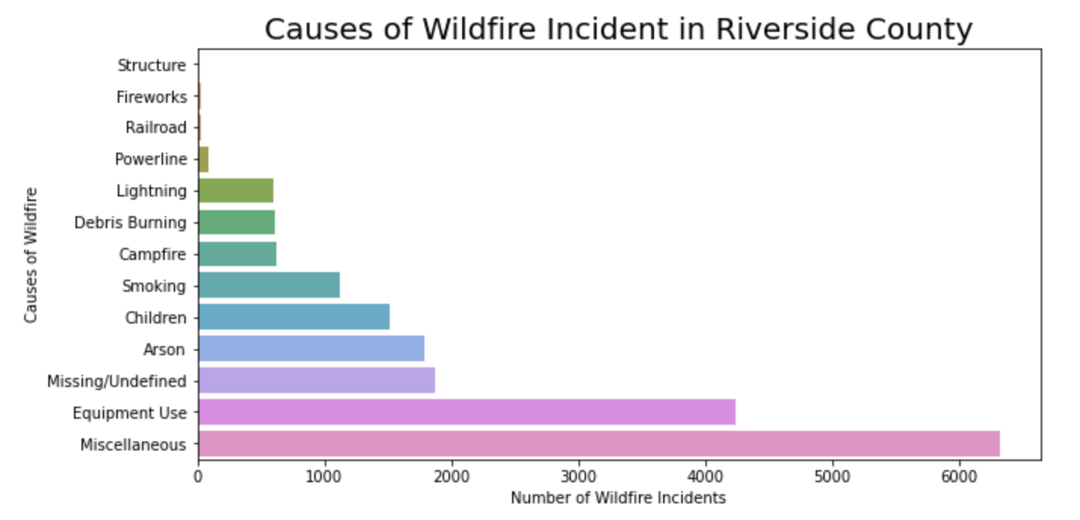
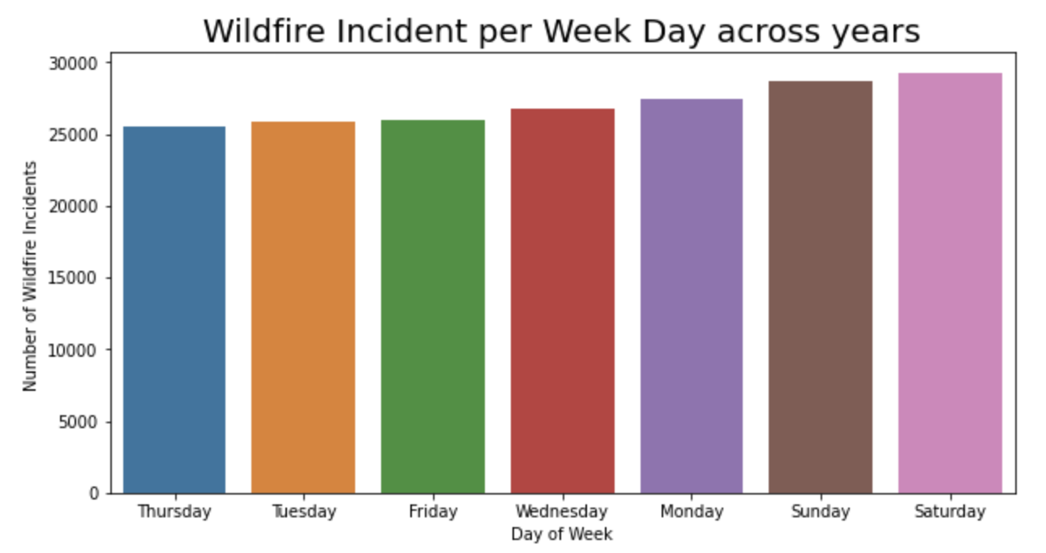
Exploratory Data Analysis
Equipment usage was one of the major cause along with Arson that caused wildfire in Riverside County. We do see children, smoking and campfire as well.
We also noticed that there was a gradual increase in the wildfire events as we approached the weekends. We can deduce that as people go out for camping and barbeque during summer the number of incidents due to careless events increase.

Slide 9
Data Preparation
Data Gathering | Data was gathered from two different resources.
Merging Data | As we had Data from two different sources i.e. Fire event data and weather data. We had to merge data based on the date range when we had both the data available.
Reverse Geocoding | As most of the Data did not have location information, we used API’s to fill that data into the merged data
Handling Null Values | We handled NA values and filled them out with the column mean value.
Encoding Categorical Data | We encoded categorical data by creating dummies and then expanding the table
Date Time Conversion | In this process we had to deal with date and time data as well. We converted the date and extracted features like months, day of the week and the time of the day etc.

Slide 10
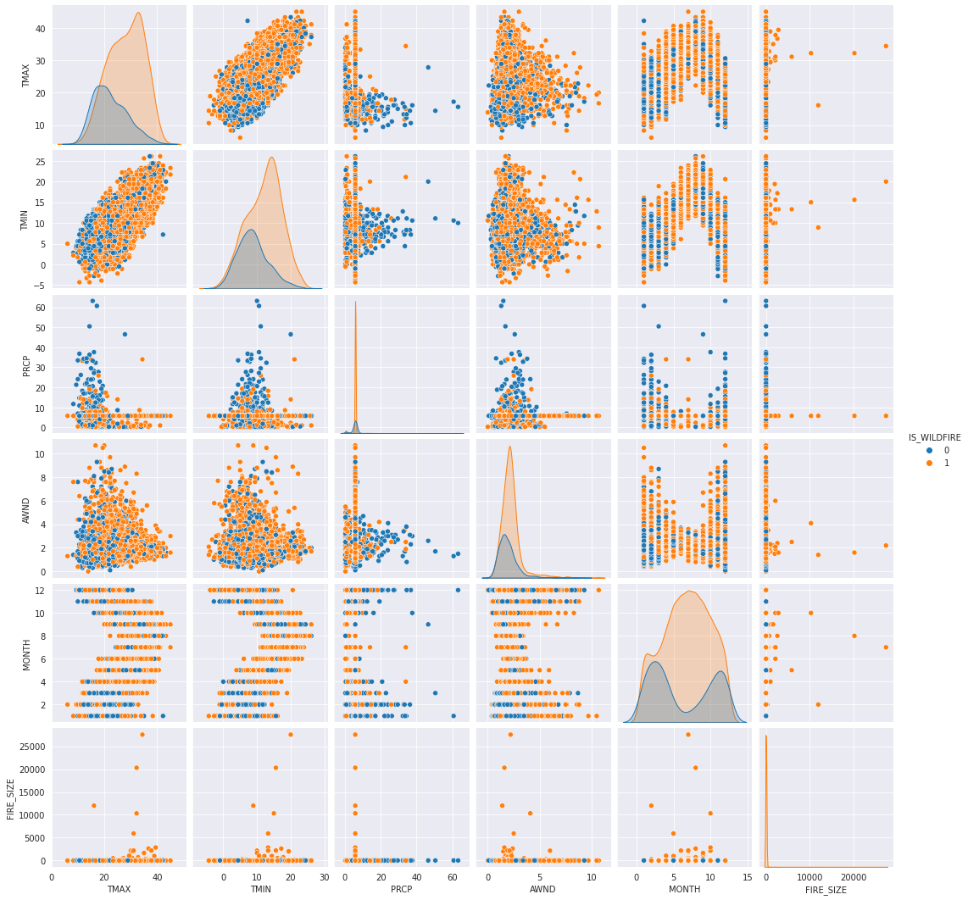
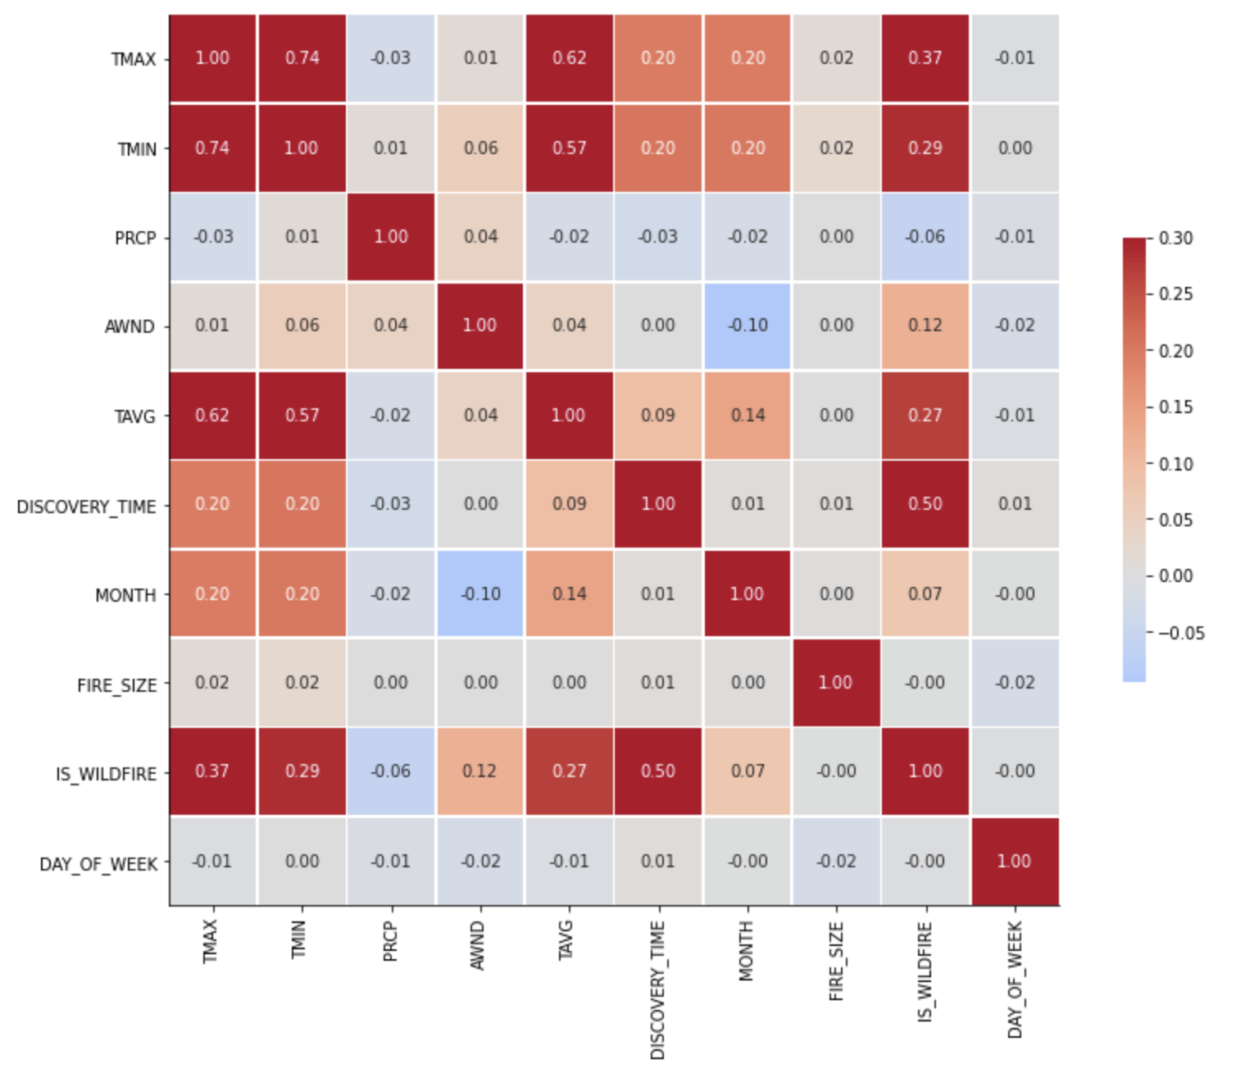
Data Preparation Via EDA
We noticed here that the TMAX, TMIN, TAVG were significantly correlated where as DISCOVERY_TIME and MONTH also showed slight correlation when compared to the rest of the relevant data.

Slide 11


Performance Evaluation
MODEL | ACCURACY | F1 SCORE | MODEL CONSIDERED
Support Vector Classifier | 83% | 79%
Linear Support Vector Classifier | 82% | 78%
Decision Tree | 77% | 72%
KNN | 76% | 74%
Logistic Regression | 82% | 78%
Random Forest Classifier | 82% | 78%

Slide 12
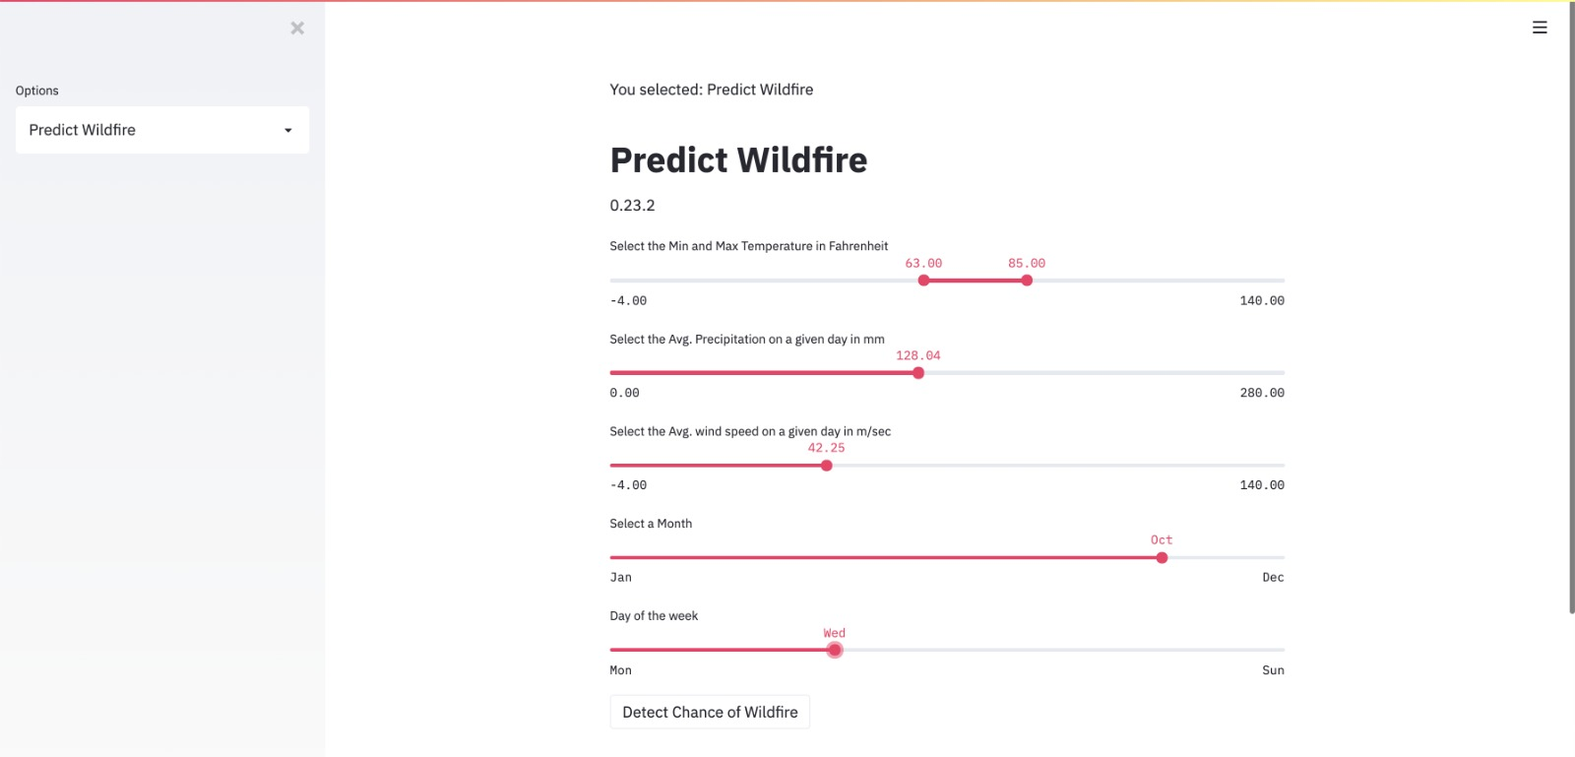
Demo
Elevator Pitch: https://youtu.be/Xsv1V4MFgWQ

Slide 13
Technical Difficulty
Weather data collection for the Riverside county required a lot of effort because a direct source was not available. We had to go through various weather stations listed across the county to get the required data.
Addressing missing values for the county information also required us to programmatically fill the data from ArcGIS service. This required us to make calls to the service and reverse geocode the information in our data using the latitude and longitudes via ArcGIS API’s.
Data cleaning and merging the various data from multiple information sources was an issue. There were lot of comparisons to be made in order to join the data coming from two different sources.

Slide 14
Publication and Lesson Learnt
Planning to submit for IEEE conference
We are looking forward to prepare for a submission of our paper in an upcoming IHSI 2021 International Conference.
- Data gathering and Feature engineering played a pretty important role.
- There was no perfect one stop solution for data gathering and we did feel the need of referring multiple data sources.
- Got to better understand the various libraries available within sklearn which made the journey easy.
- Outliers cannot be ignored.
- No free lunch theorem is real.

Slide 15
Teamwork
Slack was used as the medium of communication across the team.
We followed agile methodology for project management and its execution. We met as a team daily at 4PM.
The version control system used was git and the project was pushed to GitHub to be stored.
Team communication played an important role in development of the project.

Slide 16
Q & A

Slide 17
Thank You

Slide 18
Teamwork
Step | Task | Assignee | Status | Expected date | Completion date
1. | Project idea brainstorming | Kumuda, Raghava, Shiv | Completed | 9/7/20 | 9/8/20
2. | Project idea finalization | Kumuda, Raghava, Shiv | Completed | 9/10/20 | 9/10/20
3. | Literature survey | Kumuda, Raghava, Shiv | Completed | 9/15/20 | 9/15/20
4. | Project proposal | Kumuda, Raghava, Shiv | Completed | 9/23/20 | 9/25/20
5. | Project Setup | Shiv, Raghava | Completed | 9/30/20 | 9/30/20
6. | Data research and procuring available data sets | Raghava, Shiv | Completed | 5/10/20 | 10/7/20
7. | API invocation to generate, gather fire and weather data | Shiv, Kumuda | Completed | 7/10/20 | 10/7/20
8. | Data analysis to review the procured data set and identify the useful attributes | Shiv, Kumuda | Completed | 10/10/20 | 10/14/20
9. | Integrate the data set obtained from multiple sources and get the final data set | Raghava, Shiv | Completed | 10/10/20 | 10/14/20
10. | Feature engineering to finalize the attribute set | Raghava, Shiv | Completed | 10/14/20 | 10/21/20
11. | Data pre-processing to remove duplicates, handle null values and incorrect data format | Kumuda, Raghava | Completed | 10/28/20 | 10/28/20
12. | Perform EDA to evaluate the data | Kumuda, Raghava | Completed | 10/30/20 | 11/1/20
13. | Intermediate status report | Kumuda, Raghava, Shiv | Completed | 11/4/20 | 11/4/20
14. | Model implementation and analysis – SVM | Shiv | Completed | 11/15/20 | 11/24/20
15. | Model implementation and analysis – Decision tree | Kumuda | Completed | 11/15/20 | 11/24/20
16. | Model implementation and analysis – Random forest | Raghava | Completed | 11/15/20 | 11/24/20
17. | Model evaluation – Evaluate the models obtained from previous step and use the model with highest accuracy for prediction | Kumuda, Raghava, Shiv | Completed | 11/20/20 | 11/25/20
18. | Data visualization – Provide a simple UI/form to accept test data and predict wildfire. The patterns received from the models implemented is visualized through graphical representation. | Kumuda, Raghava, Shiv | Completed | 11/25/20 | 11/26/20
19. | Project report | Kumuda, Shiv | Completed | 12/1/20 | 12/1/20
20. | Project demo and presentation | Raghava, Shiv, Kumuda | Completed | 12/1/20 | 12/1/20

Slide 19
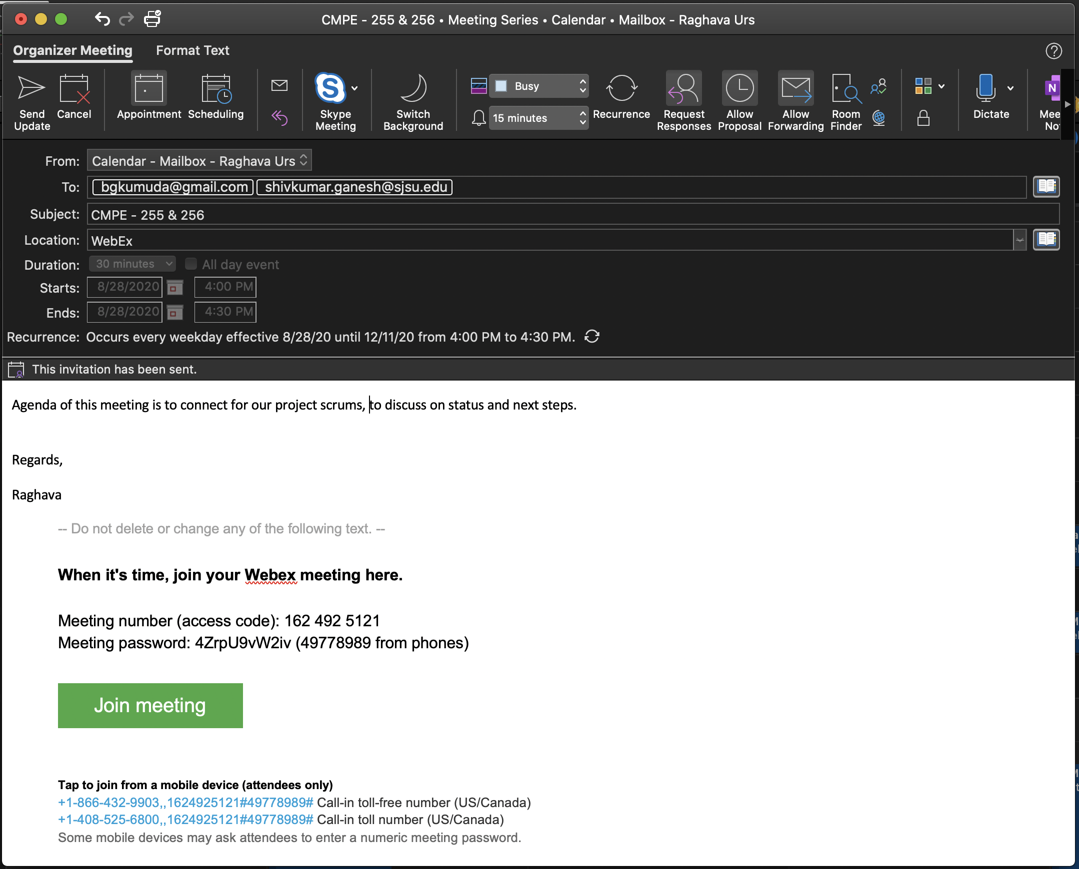
Scrum meeting details

